Slide 1
OWASP Software Assurance Maturity Model (SAMM)
OSS19 Training

Slide 2
What is SAMM?
From the Core Model document (1.5): “The Software Assurance Maturity Model (SAMM) is an open framework to help organizations formulate and implement a strategy for software security that is tailored to the specific risks facing the organization.”
Notes:
What is SAMM?
SAMM about trying to help you structure what you have/are doing and build a plan for how to improve software security
SAMM was defined with flexibility in mind such that it can be utilized by small, medium, and large organizations using any style of development. Additionally, this model can be applied organization-wide, for a single line-of-business, or even for an individual project.
SAMM is full of useful resources that will help with evaluating an organization's current practices, recommendations or suggestions for growing and maturing those practices, providing a way to demonstrate concrete improvements, and defining and measures security activities throughout the lifecycle.
One of the big benefits of SAMM is that it is vendor agnostic.
SAMM can be done in-house or you can have one of several appsec consulting firms help you with the assessment, goals, plans, roadmaps, etc.

Slide 3
What is SAMM?
“The resources provided by SAMM will aid in:
Evaluating an organization’s existing software security practices.
Building a balanced software security assurance program in well-defined iterations.
Demonstrating concrete improvements to a security assurance program.
Defining and measuring security-related activities throughout an organization.”
Notes:
What is SAMM?
SAMM about trying to help you structure what you have/are doing and build a plan for how to improve software security
SAMM was defined with flexibility in mind such that it can be utilized by small, medium, and large organizations using any style of development. Additionally, this model can be applied organization-wide, for a single line-of-business, or even for an individual project.
SAMM is full of useful resources that will help with evaluating an organization's current practices, recommendations or suggestions for growing and maturing those practices, providing a way to demonstrate concrete improvements, and defining and measures security activities throughout the lifecycle.
One of the big benefits of SAMM is that it is vendor agnostic.
SAMM can be done in-house or you can have one of several appsec consulting firms help you with the assessment, goals, plans, roadmaps, etc.

Slide 4
Why SAMM?
”The most that can be expected from any model is that it can supply a useful approximation to reality: All models are wrong; some models are useful.”
– George E. P. Box
Notes:
I like this quote from George Box, who has been called one of the great statistical minds of the 20th century.
<quote>
The point is that you can’t find a model that will exactly describe reality, there too many variables. Models are built in the academic world, we live in the real world.
But, you can have a model that is close enough to be useful, and that is what SAMM is.

Slide 5
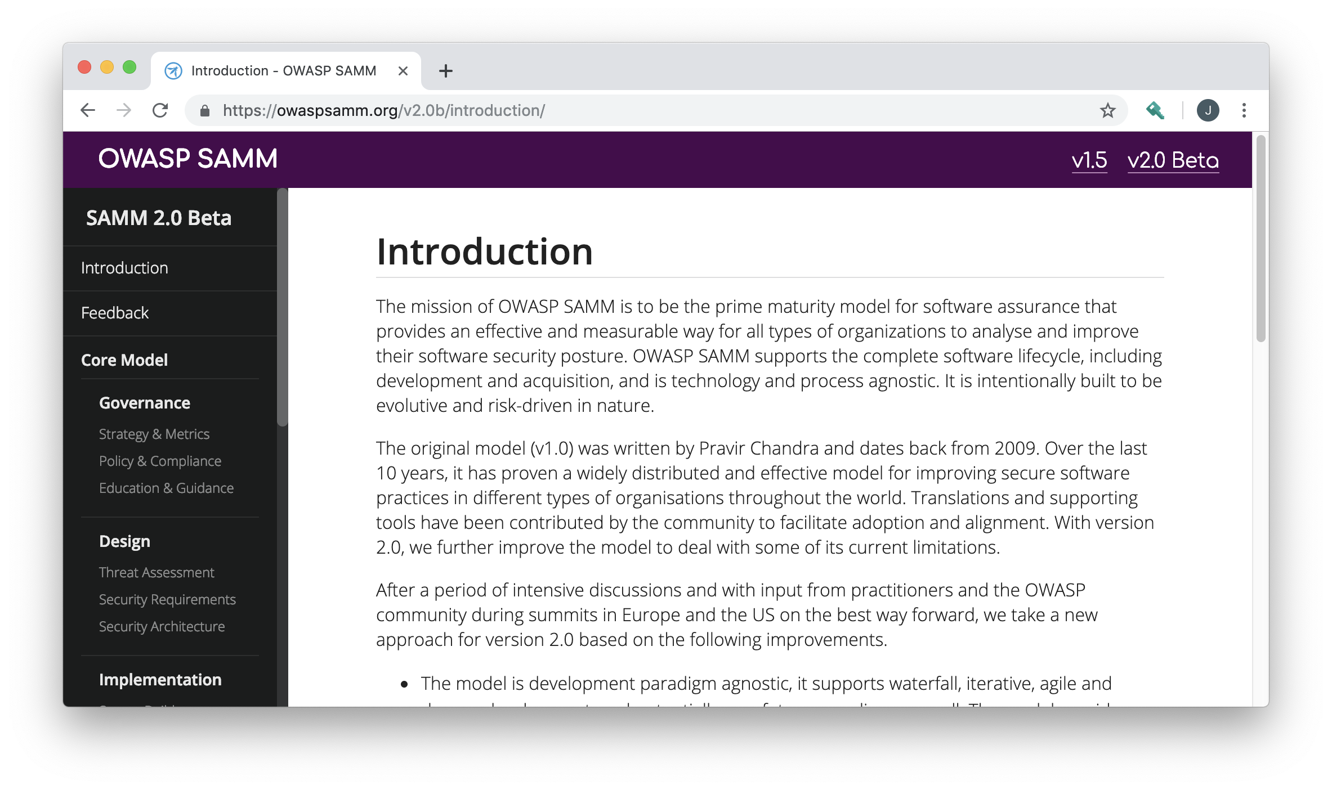
Core Principles of SAMM
An organization’s behavior changes slowly over time
Changes must be iterative while working toward long-term goals
There is no single recipe that works for all organizations
A solution must enable risk-based choices tailored to the organization
Guidance related to security activities must be prescriptive
A solution must provide enough details for non-security-people
Overall, must be simple, well-defined, and measurable
OWASP Software Assurance Maturity Model (SAMM)
Notes:
SAMM is built on a few core principles.
First, an organization's behaviour changes slowly over time. Changes need to be smaller and iterative to really take hold and make a difference.
Second, there is no single recipe that works for all organizations. SAMM is built with this in mind, and supports an organization building a program that is tailored to their risk profile, culture, IT maturity, etc.
Thirdly, Guidance related to security activities must be prescriptive. Too often, security initiatives fail due to poor details, lack of communication, or invalid assumptions.
Overall, the success of the program will be based on being simple, well-defined, and measurable.

Slide 6
Project History
March 2016
February 2017
BETA – Jan 2019
OWASP SAMM 1.1
OWASP SAMM 1.5
OWASP SAMM 2.0
OpenSAMM 1.0
March 2009
OpenSAMM 1.1
Notes:
Version 1.0 of OpenSAMM was originally created through the OpenSAMM Project led by Pravir Chandra (chandra@owasp.org), an independent software security consultant. Creation of the first draft was made possible through funding from Fortify Software, Inc.
After a number of years, a small group got together at OWASP and worked together to breathe some life into SAMM as an OWASP project.
Version 1.1 of SAMM expanded and restructured its predecessor into four complementary resources:
Core Document: that describes the core SAMM model
How-To Guide: that explains how to apply the model
Quick Start Guide: to help accelerate learning and adoption
Toolbox (spreadsheet): that provides simple automation for data collection, metrics, and graphs.
The project team released v1.5 of SAMM in February 2017, which incorporated a refinement of the scoring model, to provide more granularity to the scoring in an assessment. Now an organization will get credit for all the related work done in a practice rather than having the base number held at the highest completed maturity level.
The updated scoring model was designed to help SAMM assessors and organizations avoid the awkward discussion on whether to mark an answer yes or no when it is honestly something in between, and to show incremental improvements.
The project team began working in earnest on Version 2.0 in late 2017, and officially released the Beta draft for comment at the end of January. In this update, we’ve expanded the breadth of business functions and practices covered, and are working through improvements to the the scoring model to include additional factors.

Slide 7
The Core Team
Sebastien (Seba) Deleersnyder – Project Co-Leader, Belgium
Bart De Win – Project Co-Leader, Belgium
Chris Cooper – Webmaster, United Kingdom
John DiLeo – New Zealand
Daniel Kefer – Germany
Nessim Kisserli – Belgium
Yan Kravchenko – United States
Notes:
Work on Version 2.0 has been performed mostly by a core team of seven volunteers. Since starting on the new version, the team has met in person three times, and have coordinated our work through fortnightly team calls.

Slide 8
The Core Framework
Version 1.5
Version 2.0
Four Business Functions
Governance
Construction
Verification
Operations
Adds a Fifth Business Function
Governance
Design
Implementation
Verification
Operations

Slide 9
The Security Practices – SAMM 2.0
Governance
Strategy & Metrics
Policy & Compliance
Education & Guidance
Design
Threat Assessment
Security Requirements
Security Architecture
Implementation
Secure Build
Secure Deployment
Defect Management
Verification
Architecture Assessment
Requirements-Driven Testing
Security Testing
Operations
Incident Management
Environment Management
Operational Management

Slide 10
The Maturity Levels
OWASP SAMM - 3 levels
Level 1
Level 2
Level 3
Rough alignment with CMMI levels
1 Initial
2(a) (Partially) Managed
2(b) (Fully) Managed
3 Defined
4 Quantitatively Managed
5. Optimizing

Slide 11
Activity Streams Example – Operational Management
A: Data Protection
Level 1: Basic Data Protections in Place
Level 2: Data cataloged and data protection policy established
Level 3: Data policy breaches detected and acted upon
B: System Decomm / Legacy Management
Level 1: Identification of unused apps/services
Level 2: Decommissioning and legacy migration processes in place
Level 3: Proactive handling of legacy applications/ services

Slide 12
Where to Find SAMM
OWASP SAMM Web Site: https://owaspsamm.org
Version 1.5 documents and toolkit
Version 2.0 Beta content – Auto-updates from GitHub repo
GitHub Project: https://github.com/OWASP/samm
Includes background information and archived documents
SAMM Project Page on OWASP Web Site
Includes information on current sponsors
Notes:
The core team provides monthly updates to the large community, as well.

Slide 13
Pain Points with Scoring in SAMM 1.5
Strategy & Metrics, Level 1: Is there a software security assurance program in place?
Available Responses:
No
Yes, it‘s less than a year old
Yes, it‘s a number of years old
Yes, it‘s a pretty mature program
But, what about…
Quality of the program?
Currency of the program? Has it been reviewed/updated?
How do you know the program is still relevant?

Slide 14
Consider Multiple Dimensions
Coverage / Standardisation
Quality

Slide 15
Maturity Score = Quality × Coverage
Combining Dimension Scores
Quality
0.4
Coverage / Standardization

Slide 16
Education & Guidance Practise
0.8
0.25
0.0
Level 1
Relevant employees
are provided
an awareness training
Level 2
Employees are provided
role specific trainings
Level 3
Employee‘s knowledge
is regularly assessed

Slide 17
Open Questions
Response scales/values for quality and coverage questions
Four options? Five?
Linear?
How to compute overall maturity score from individual metric scores across levels
Level 2 significantly more expensive than Level 1

Slide 18
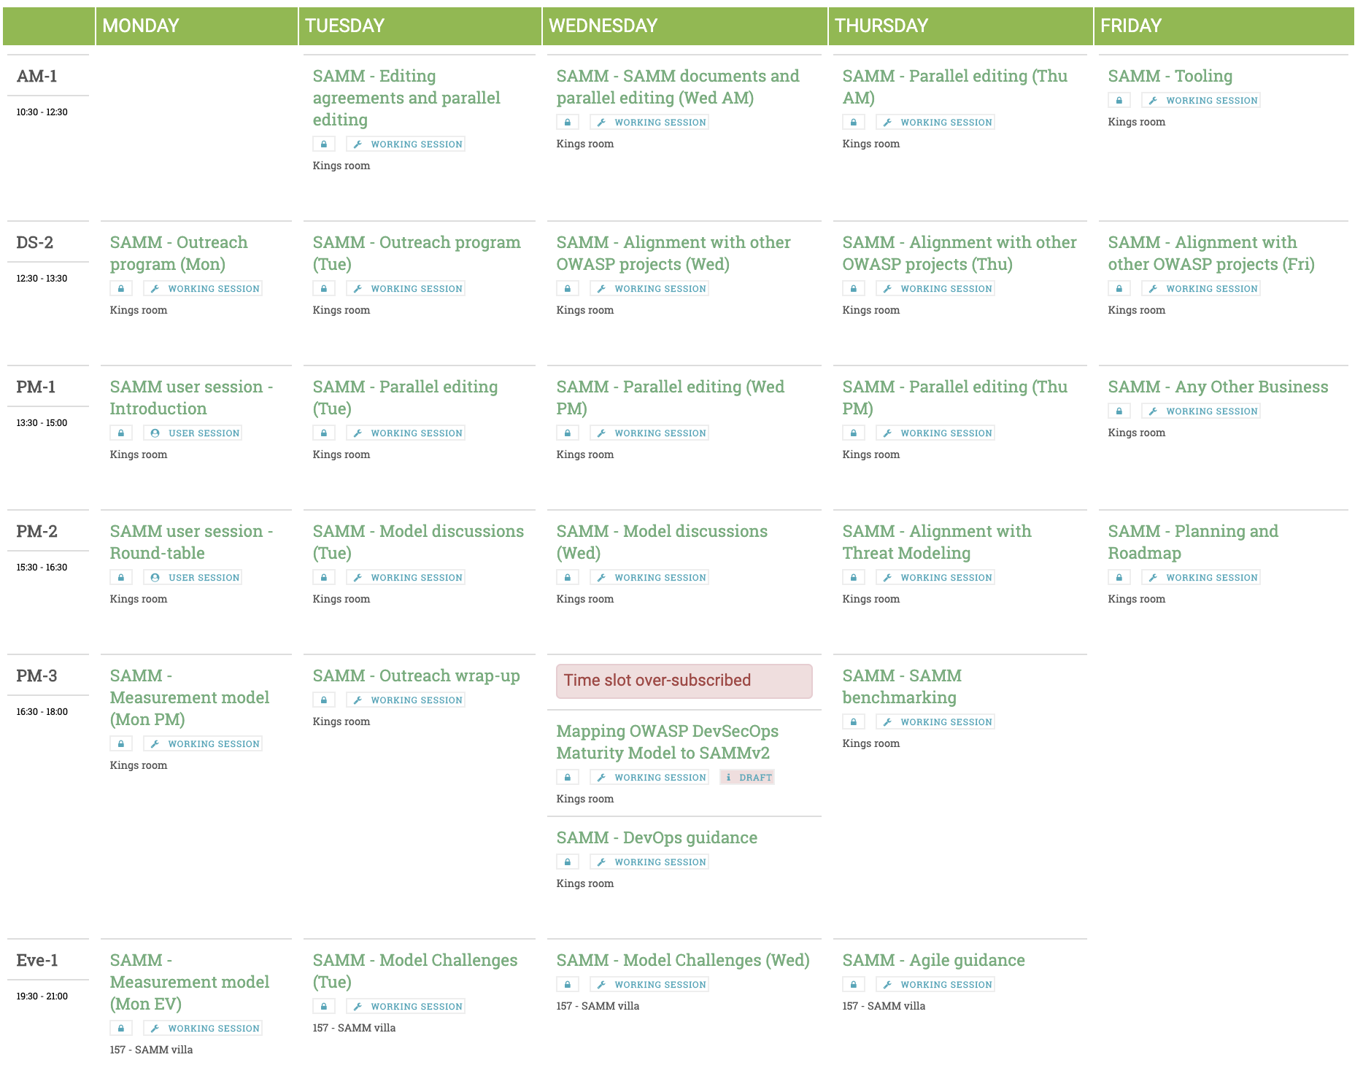

Slide 19
Interested in Getting Involved?
Provide comments on the current draft
Submit issues in GitHub project: https://github.com/OWASP/samm
Join our monthly project calls
Second Wednesday of the month, 9:30 p.m. Central European Time
Join our Slack Channel
#project-samm on the OWASP Slack (https://owasp.slack.com/)
Get our newsletter
http://eepurl.com/gl9fb9
Notes:
The core team provides monthly updates to the large community, as well.

Slide 20


Thank You to Our Sponsors
Sponsorship opportunities still available!

